Slide 1
Fundamentals of Entrepreneurship
Lecture 5 & 6

Slide 2
Recognizing Opportunities and Generating Ideas
What is An Opportunity?
An opportunity is a favorable set of circumstances that
creates a need for a new product, service, or business.

Slide 3
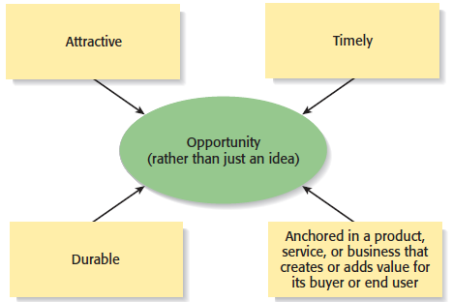
What is an Opportunity?
Four Essential Qualities of an Opportunity

Slide 4

Three Ways to Identify an Opportunity

Slide 5
First Approach: Observing Trends
Observing Trends
Trends create opportunities for entrepreneurs to pursue.
The most important trends are:
Economic forces
Social forces
Technological advances
Political action and regulatory change
It’s important to be aware of changes in these areas.

Slide 6
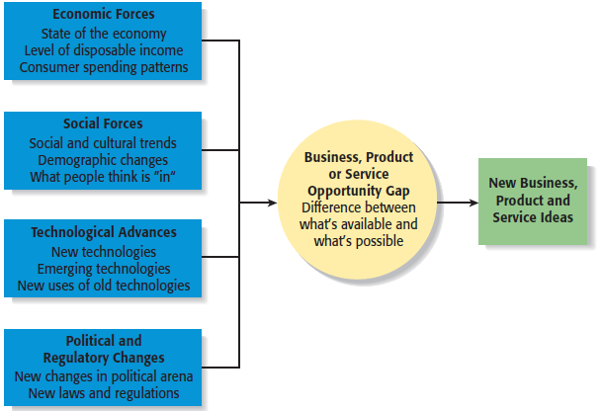
First Approach: Observing Trends
Environmental Trends Suggesting Business or Product Opportunity Gaps

Slide 7
Trend 1: Economic Forces
Economic trends help determine areas that are ripe for new start-ups and areas that start-ups should avoid.
Example of Economic Trend Creating a Favorable Opportunity
A weak economy favors start-ups that help consumers save money.

Slide 8
Trend 2: Social Forces
Social trends alter how people and businesses behave and set their priorities. These trends provide opportunities for new businesses to accommodate the changes.
Examples of Social Trends
An increasing focus on health and wellness
Increasing interest in “green” products

Slide 9
Trend 3: Technological Advances
Advances in technology frequently create business opportunities

Slide 10
Trend 4: Political Action and Regulatory Changes
Political action and regulatory changes also provide the basis for opportunities.
Example
Laws to protect the environment have created opportunities for entrepreneurs to start firms that help other firms comply with environmental laws and regulations.

Slide 11
Second Approach: Solving a Problem
Solving a Problem
Sometimes identifying opportunities simply involves noticing a problem and finding a way to solve it.
These problems can be pinpointed through observing trends and through more simple means, such as intuition, serendipity, or change.

Slide 12
Third Approach: Finding Gaps in the Marketplace
Gaps in the Marketplace
A third approach to identifying opportunities is to find a gap in the marketplace.
A gap in the marketplace is often created when a product or service is needed by a specific group of people but doesn’t represent a large enough market to be of interest to mainstream retailers or manufacturers.

Slide 13
Personal Characteristics of the Entrepreneur
Characteristics that tend to make some people better at recognizing opportunities than others
Prior Experience
Cognitive Factors
Social Networks
Creativity

Slide 14
Prior Experience
Prior Industry Experience
Several studies have shown that prior experience in an industry helps an entrepreneur recognize business opportunities.
By working in an industry, an individual may spot a market niche that is underserved.
It is also possible that by working in an industry, an individual builds a network of social contacts who provide insights that lead to recognizing new opportunities.

Slide 15
Cognitive Factors
Cognitive Factors
Studies have shown that opportunity recognition may be an innate skill or cognitive process.
Some people believe that entrepreneurs have a “sixth sense” that allows them to see opportunities that others miss.
This “sixth sense” is called entrepreneurial alertness, which is formally defined as the ability to notice things without engaging in deliberate search.

Slide 16
Social Networks
Social Networks
The extent and depth of an individual’s social network affects opportunity recognition.
People who build a substantial network of social and professional contacts will be exposed to more opportunities and ideas than people with sparse networks.
Research results suggest that between 40% and 50% of people who start a business got their idea via a social contact.

Slide 17
Creativity
Creativity
Creativity is the process of generating a novel or useful idea.
Opportunity recognition may be, at least in part, a creative process.
For an individual, the creative process can be broken down into five stages, as shown on the next slide.

Slide 18
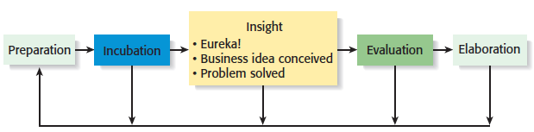
Creativity
Five Steps to Generating Creative Ideas

Slide 19
Full View of the Opportunity Recognition Process
Depicts the connection between an awareness of emerging trends and the personal characteristics of the entrepreneur

Slide 20
Techniques for Generating Ideas
Brainstorming
Focus Groups
Library and Internet Research

Slide 21
Brainstorming
Brainstorming
Is a technique used to generate a large number of ideas and solutions to problems quickly.
A brainstorming “session” typically involves a group of people, and should be targeted to a specific topic.
Rules for a brainstorming session:
No criticism.
Freewheeling is encouraged.
The session should move quickly.
Leap-frogging is encouraged.

Slide 22
Focus Groups
Focus Group
A focus group is a gathering of five to ten people, who have been selected based on their common characteristics relative to the issues being discussed.
These groups are led by a trained moderator, who uses the internal dynamics of the group environment to gain insight into why people feel the way they do about a particular issue.
Although focus groups are used for a variety of purposes, they can be used to help generate new business ideas.

Slide 23
Library and Internet Research
Library Research
Libraries are an often underutilized source of information for generating new business ideas.
The best approach is to talk to a reference librarian, who can point out useful resources, such as industry-specific magazines, trade journals, and industry reports.
Simply browsing through several issues of a trade journal or an industry report on a topic can spark new ideas.

Slide 24
Library and Internet Research
Internet Research
If you are starting from scratch, simply typing “new business ideas” into a search engine will produce links to newspapers and magazine articles about the “hottest” new business ideas.
If you have a specific topic in mind, setting up Google or Yahoo! e-mail alerts will provide you with links to a constant stream of newspaper articles, blog posts, and news releases about the topic.
Targeted searches are also useful.

Slide 25
Other Techniques
Customer Advisory Boards
Some companies set up customer advisory boards that meet regularly to discuss needs, wants, and problems that may lead to new ideas.
Day-In-The-Life Research
A type of anthropological research, where the employees of a company spend a day with a customer.

